Slide 1
Molecules!

Slide 2
What/Where?
What are they?
Where are they found?
Are they all the same distance apart?

Slide 3
Movement
4. Do they move?
5. What happens if you heat them up or cool them down?

Slide 4
Volume
The word volume can be used to describe a level of sound.
6. What else does it mean?

Slide 5
Density
7. What does density have to do with molecules?
8. Is the density of something static (i.e. does it always stay the same)? Explain your answer.

Slide 6
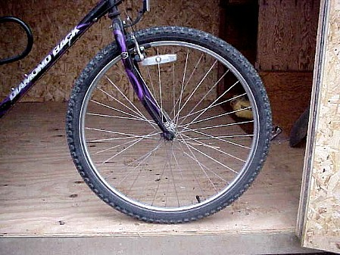
Air Molecules get closer together when cold

Slide 7
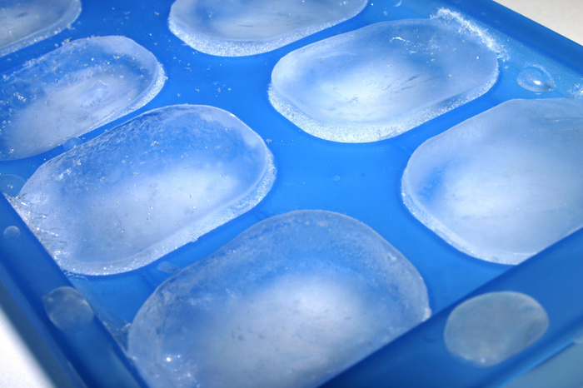
Water Molecules EXPAND when frozen

Slide 8
Questions?
9. What questions do you now have about molecules?

